Slide 1
Drug Administration
Dr. Moustafa AL-Shammari

Slide 2
Objective
By the end of lecture, the student will be able to:
Identify a brief introduction about drug and medication .
List the essential principles for the administration of medications.
Discuss the steps of the different routes of administration of medications.
Calculate a safe drug dosage needed for the individual child.

Slide 3
Introduction:
child responds to drugs more rapidly and unpredictably than an adult does for this reason; pediatric drug administration requires special care. Such factors as age, weight, body surface area, and drug form and route may dramatically affect a child's response to a drug. For example, because of his thin epithelium, a neonate or an infant absorbs topical medications much faster than an older child does.
Notes:
1. AgeNeonates & Infants: Immature liver and kidney function lead to slower drug metabolism and excretion, increasing the risk of drug accumulation and toxicity.Older Children: Enzyme activity in the liver matures, sometimes leading to faster drug metabolism than in adults, requiring higher doses per kg for some drugs (e.g., theophylline).2. WeightPediatric drug dosing is often weight-based (mg/kg) to ensure an appropriate therapeutic effect while minimizing toxicity.Overweight or underweight children may require dose adjustments, as body composition affects drug distribution.3. Body Surface Area (BSA)Used for more precise dosing in narrow therapeutic index drugs (e.g., chemotherapy, corticosteroids).BSA-based dosing accounts for metabolic rate differences better than weight-based dosing.Formula for BSA (m²):𝐵𝑆𝐴=(𝐻𝑒𝑖𝑔ℎ𝑡 in cm)×(𝑊𝑒𝑖𝑔ℎ𝑡 in kg)3600BSA= 3600(Height in cm)×(Weight in kg)​ ​ 4. Drug Form and Route of AdministrationOral (PO): Gastric pH, enzyme activity, and gastric emptying rate affect absorption. Liquid formulations are preferred for young children.Intravenous (IV): Provides rapid effect but requires careful monitoring for toxicity.Intramuscular (IM): Muscle mass and blood flow affect absorption; neonates have poor perfusion, leading to unpredictable IM absorption.Topical: Neonates have thin skin, leading to increased absorption of topical drugs (e.g., corticosteroids, alcohol-based products), increasing the risk of systemic toxicity.Rectal (PR): Used for patients who cannot take oral medications, but absorption may be erratic due to variable rectal blood flow.

Slide 4
General steps for administer medication
Assess the child's condition to determine the need for the medication and the effectiveness of previous therapy.
Carefully observe the child for a rash, pruritus, cough, or other signs of an adverse reaction to a previously administered drug.
Identify the child by comparing the name on his wristband with that on the medication card. If the child can talk and respond, ask him his name.
Explain the procedure to the child and his parents. Use terms the child can understand.
Provide privacy, especially for an older child.

Slide 5

Drug Administration Routes

Slide 6
Six right for administer medication
1-Right Medication
2-Right Patient
3-Right Dosage
4- Right Route
5- Right Time
6-Documentation

Slide 7
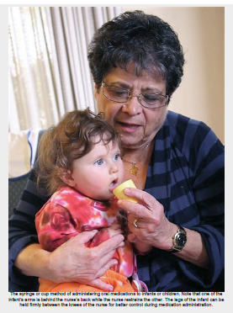
Administering Oral Medications

Slide 8
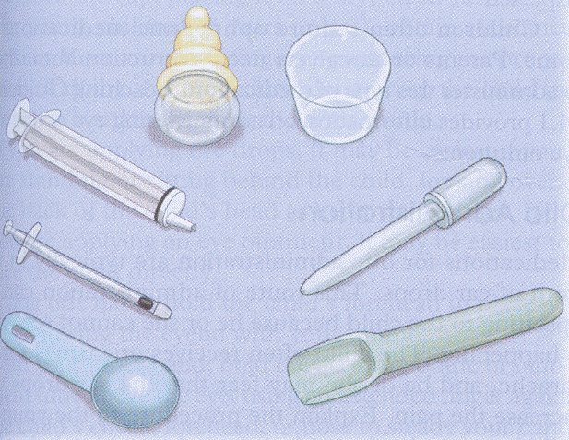
Equipment for oral medications
Prescribed medication
Plastic disposable syringe, plastic medicine dropper, or spoon
Medication cup
Water, syrup, or jelly (for tablets)
Optional: fruit juice.

Slide 9
Steps of Oral Administration
Verify medication orders and assemble supplies.
Place the infant’s legs between your knees to maintain control of them.
Place one of the infant’s arms behind your back and restrain the other arm by “hugging” the child (this helps to prevent the child from tipping the medication cup).
Give the medication slowly by cup or syringe to allow the child time to swallow. An older child may be given the choice to self-administer the medication by cup or syringe.

Slide 10
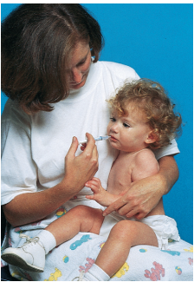
Cont…
5. Provide “chasers” of water, fruit juice, or frozen ice-pops to help lessen the residual taste of the medicine. The patient’s age and diet prescription are considered when choosing a chaser.
6. Document in the medication administration record (MAR) the medication, route, time, and dose given
Measure a drug ordered in teaspoons in milliliters; the established standard is 5 ml/tsp.

Slide 11
Notices
Medication is administered slowly, especially if the child is crying. The child’s head and shoulders are elevated to prevent aspiration. Toddlers may attempt to push away the medicine cup. In anticipation of this response, the nurse holds the child in a “hug” position in the nurse’s lap in a semi sitting position
The use of important sources of nutrients, foods, or liquids (e.g., orange juice) for disguising the taste of the medication is discouraged because the child may develop a distaste for these foods.
If a nasogastric tube is in place, the nurse tests for proper placement of the tube before pouring medication into the funnel. A small amount of water is administered afterward to flush (cleanse) the tube.

Slide 12
Never pinch the infant or child’s nostril when administrating medications
Don’t place medication in a baby’s bottle
Suspension must be administered immediately after measurement to prevent settling and giving an incomplete dose
Slide the syringe or medicine dropper into the infant's mouth alongside his tongue. Release the medication slowly
If the medication is in tablet form, first crush the tablet, if appropriate, and mix it with water, syrup, or jelly. Use a spoon, syringe, or dropper to administer the medication. (Toddler)
Giving medication in tablet or capsule form for older enough child (between ages 4 and 6), you should teach him how to swallow solid medication.

Slide 13
Administering parenteral medications
Nose Drops
Ear Drops
Eye Drops
the principles for administering nose drops, ear drops, and eye drops to children are essentially the same as for adults. Infants and small children may need to be restrained in a mummy restraint

Slide 14
NURSING Tips
To reduce unpleasant sensations when administering medications:
Eye—Apply finger pressure to the lacrimal punctum at the inner aspect of the eyelid for 1 minute to prevent drainage of medication to the nasopharynx and the unpleasant “tasting” of the drug.
Ear—Allow medications stored in the refrigerator to warm to room temperature before instillation.
Nose—Position the child with the head hyperextended to prevent strangling sensations caused by medication trickling into the throat rather than up into the nasal passages.

Slide 15
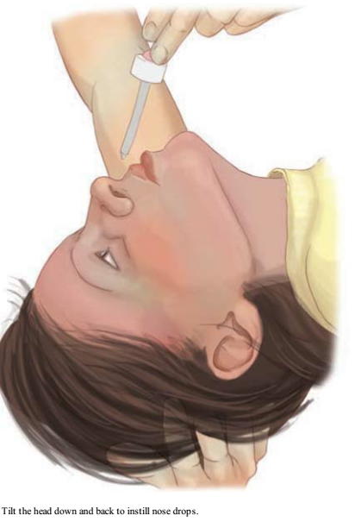
Nose drops

Slide 16
Steps
1. Immobilize the infant with a mummy restraint.
2. Wipe excess mucus from nose with a tissue.
3. Place the infant on his or her back, with the head over the side of the mattress or the neck extended over a pillow.
4. Encircle the infant’s cheeks and chin with the left arm and hand to steady.
5. Instill drops with the right hand.
6. Keep infant in this position for 30 seconds to 1 minute to allow the drops to reach the proper area.
7. Remove restraints. Make the infant comfortable.
8. Remove gloves and perform hand hygiene
9. Record: time, name of nose drops, strength, and number of drops instilled, how the patient tolerated the procedure, and untoward reactions.

Slide 17
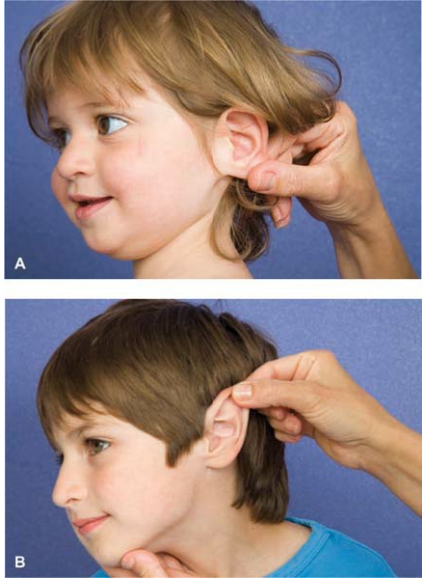
Ear drops
A. In children less than 3 years of age, pull the pinna (earlobe) of the affected ear down and back to straighten the canal.
B. In older children, pull the upper pinna (auricle) up and back to straighten the canal.

Slide 18
Steps
1. Place child in supine position with unaffected ear down.
2. Instill the ordered number of drops
3. Gently massage the area in front of the ear to facilitate entry of the drops.
4. Keep the patient in a supine position for a few minutes to permit the fluid to be absorbed.
5. Remove gloves and perform hand hygiene.
6. Document the time, name of drug, number of drops administered, area (right or left ear), untoward reactions, and whether or not the patient obtained relief.

Slide 19
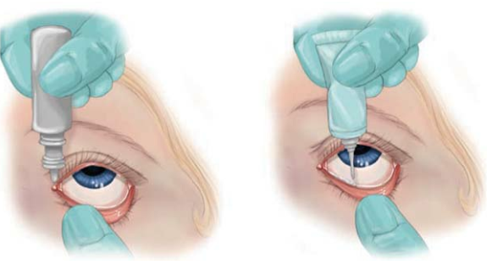
Eye drops and creams

Slide 20
Steps:
Ophthalmic medication is administered to a child in the same manner as for the adult
The child is informed of the need for the medication.
The patient is identified, and the orders and the label on the bottle are checked for correct medication and concentration.
The nurse ascertains which eye requires treatment.
Hand hygiene is performed before and after the procedure, and clean gloves are worn. With the thumb and index finger, gentle pressure is applied in opposite directions to open the eye.
The older child is instructed to “look up.” The nurse supports his or her hand on the patient’s forehead, and instills the medication into the center of the lower lid (conjunctival sac)
The child is instructed to close the eye but not to squeeze it, because this could expel some of the solution.

Slide 21
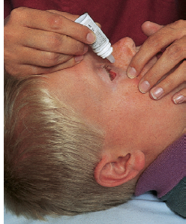
Ointment
Ointment is applied to the same conjunctival sac as eye drops.
The mummy restraint is applied when only one nurse is available and the patient is an infant.
Occasionally children refuse to open their eyes.
The nurse must use ingenuity to coax reluctant children. It may help to involve the parents.

Slide 22
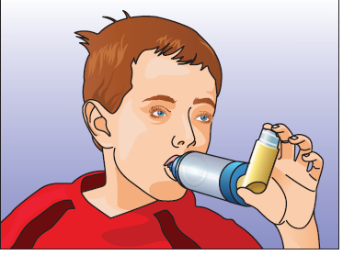
Inhaled Medication
Equipment
A pressurized canister
A plastic holder
A cap.
Often a spacer or special tube that attaches to the inhaler is used to increase the amount of medication delivered to the lungs per spray. A spacer has either a mouthpiece or a mask for ease of administration and is specific to the child’s developmental need.

Slide 23
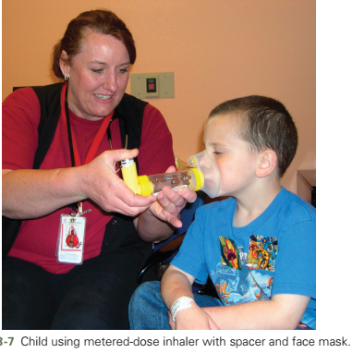
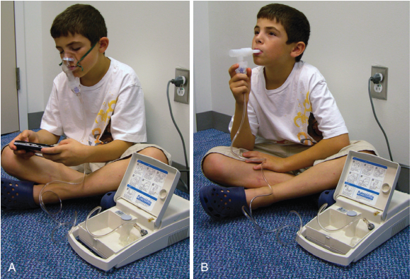
Inhaled Medication
Administering inhaled medication to children through a nebulizer has the advantage of delivering a medication directly to the needed site of action.

Slide 24
Procedure (steps)
Placing the mouthpiece fully into the mouth between the teeth
Hold the inhaler in the upright position and close the lips around the mouthpiece
Press down on the canister to dispense the medication into the spacer
Instruct the patient to breathe deeply for 3–5 seconds through the mouth, and then hold the breath for 10 seconds.
Remove the spacer from the mouth and breathe out slowly.
Patient should rinse the mouth out with water after each use of inhaled steroids to help prevent oral infections, and the spacer should routinely be washed with warm soapy water and air dried
Teach families to consistently use proper technique with their children
Often young children resist the mask when it is first introduced; however, with consistent practice eventually they will cooperate when they realize the parent is serious about giving their medications effectively.

Slide 25
Administering Intramuscular Injections
Equipment:
Prescribed medication
Appropriately sized syringe and needle
Alcohol pads or povidone-iodine solution
Gloves
Gauze pads
Cold compresses
Adhesive bandage.

Slide 26
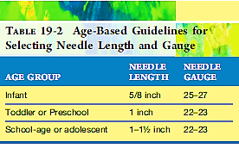

Slide 27
I.M. INJECTION SITES IN CHILDREN
When selecting the best site for a child's I.M. injection, consider:
the child's age, weight, and muscular development
the amount of subcutaneous fat over the injection site
the type of drug you're administering
the drug's absorption rate

Slide 28
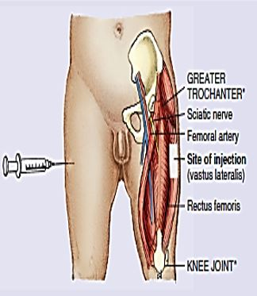
Vastus lateralis and rectus femoris
For a child under age 3, you'll typically use the vastus lateralis or rectus femoris muscle for an I.M. injection. Constituting the largest muscle mass in this age-group and have fewer major blood vessels and nerves.

Slide 29
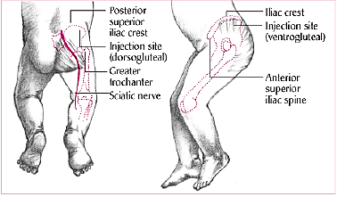
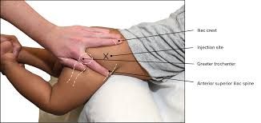
Ventrogluteal and dorsogluteal
For a child who can walk and is over age 3, use the ventrogluteal and dorsogluteal muscles. Like the vastus lateralis, the ventrogluteal site is relatively free from major blood vessels and nerves. Before you select either site, make sure that the child has been walking for at least 1 year to ensure sufficient muscle development.

Slide 30
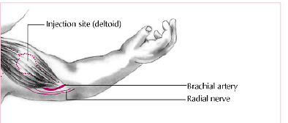
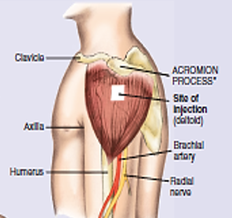
Deltoid muscle
For a child older than 18 months who needs rapid medication results, consider using the deltoid muscle for the injection. Because blood flows faster in the deltoid muscle than in other muscles, drug absorption should be faster. However, be careful when using this site because the deltoid doesn't develop fully until adolescence. In a younger child, it's small and close to the radial nerve, which may be injured during needle insertion.

Slide 31
Procedure steps
Clean the injection site with an alcohol or povidone-iodine pad. Wipe outward from the center with a spiral motion to avoid contaminating the clean area.
Prepare medication for injection. Use a 1mL syringe and in, 25gauge needle to give the injection.
Put on gloves. R:Gloves protect the nurse from contamination by blood.
Choose an injection site that's appropriate for the child's age and muscle mass. The best site for newborn intramuscular injections is the vastus lateralis muscle.
Stabilize the leg firmly while grasping the thigh between the thumb and fingers. To prevents sudden movement by the infant and possible injury

Slide 32
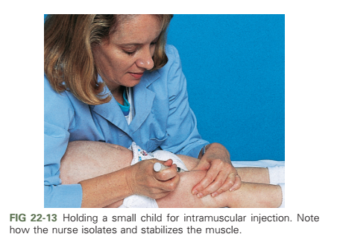

Slide 33
Insert the needle at a 90—degree angle(IM). Inject the medication.
Withdraw the needle and apply gentle pressure to the site with small gauze pad to stimulate circulation and enhance absorption
Insert the needle quickly, using a darting motion. If you're using the ventrogluteal site, insert the needle at a 45-degree angle toward the knee.
Aspirate the plunger to ensure that the needle isn't in a blood vessel. If no blood appears, inject the medication

Slide 34
Giving a subcutaneous injection (SC)
Put on gloves, and prepare the injection site with alcohol or povidone-iodine solution according to the patient's needs and hospital policy.
sites: the middle third of the upper outer arm, the middle third of the upper outer thigh, or the abdomen. You may apply a cold compress to the injection site to minimize pain.
Pinch the tissue surrounding the site between your index finger and thumb to ensure injection into the subcutaneous tissue.
Holding the needle at a 45- to 90-degree angle, quickly insert it into the tissue.
Release your grasp on the tissue, and slowly inject the medication.
Remove the needle quickly to decrease discomfort.
Unless contraindicated, gently massage the area to facilitate the drug's absorption.

Slide 35
Giving an intradermal injection
Put on gloves and pull the patient's skin taut (the site of choice is the inner aspect of the forearm).
Insert the needle, bevel up, at a 10- to 15-degree angle just beneath the outer skin layer.
Slowly inject the medication, and watch for a bleb to appear. Quickly remove the needle, being careful to maintain the injection angle.
if the injection is related to allergy testing—draw a circle around the bleb, and avoid massaging the area to avoid interfering with test results.

Slide 36
I.V. Therapy
Introduction
In children, I.V. therapy may be prescribed to administer medications or to correct a fluid deficit, improve serum electrolyte balance, or provide nourishment. Primary nursing concerns related to pediatric I.V. therapy include correlating the I.V. site and equipment with the reason for therapy and the patient's age, size, and activity level. For example, a foot or scalp vein I.V. site may be used for infants, whereas a peripheral hand or wrist vein may be more suitable for ambulatory older children.
During I.V. therapy, the nurse must continually assess the patient and the infusion to prevent fluid overload and other complications

Slide 37
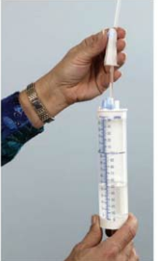
Equipment
Prescribed I.V. fluid
volume-control set with micro drip tubing
infusion pump
I.V. pole
normal saline solution or sterile dextrose 5% in water (D5W) for injection
povidone-iodine solution
alcohol pads
3-ml syringe
child-size butterfly needle or I.V. catheter
tourniquet • ½″ or 1″
sterile tape gloves

Slide 38
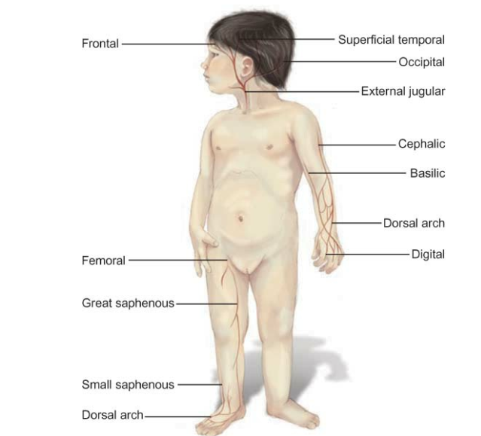
Common pediatric I.V. sites
Below are the most common sites for I.V. therapy in infants and children. Peripheral hand, wrist, or foot veins are typically used with older children, whereas scalp veins are used with an infant.

Slide 39
Procedure
Match the name on the patient's wristband with the name on the physician's order (or on the medication card). Ask the patient (or his parents) whether he's allergic to povidone-iodine solution or to any type of tape.
Explain the reason for the I.V. therapy.
Be sure to have a staff member available to assist you.
Wash your hands and put on gloves.
Select the insertion site for the butterfly needle or catheter, and avoid placing the I.V. line in the patient's dominant arm or in areas of flexion if possible. Avoid previously used or sclerotic veins.
To locate an appropriate scalp vein, carefully palpate the site for arterial pulsations. If you feel these pulsations, select another site.

Slide 40
To find an appropriate peripheral site, apply a tourniquet to the patient's arm or leg and palpate a suitable vein.
If you're inserting a butterfly needle, flush the tubing connected to the butterfly with D5W or normal saline solution.
Clean the insertion site. Unless contraindicated, use a pad containing povidone-iodine solution. Wipe with a circular motion from the insertion site's center to the outer rim. Let the solution dry.
Insert the I.V. needle into the vein. Watch for blood to flow backward through the catheter or butterfly tubing, which confirms that the needle is in the vein.
Loosen the tourniquet, and attach the I.V. tubing to the hub of the needle or catheter. Begin the infusion.
Secure and protect the I.V. line as needed.

Slide 41
Complications of I.V therapy
Infection
Fluid Overload
Electrolyte Imbalance
Infiltration
Circulatory Impairment

Slide 42
Administration of safe medication:
To administer medications safely, the following actions are necessary:
Accurately interpret the doctor's order.
Accurately calculate the amount of drug to be given for the prescribed dose.
Using the five rights for drug administration such as:
Right medication, Right dose, Right patient, Right time and Right route of administration.
Document medication administration according to agency policy.

Slide 43
Calculating Safe Dosages for Children
STEPS
Dosage based on weight in kilograms
Its necessary, convert child’s weight in pounds to kilograms. Child weighs 22 pounds.
  Conversion: 1 kilogram (kg) = 2.2 lb
  22 lb/2.2 = 10 kg
Review medication reference to determine recommended range in
milligrams/kilogram (mg/kg)

Slide 44

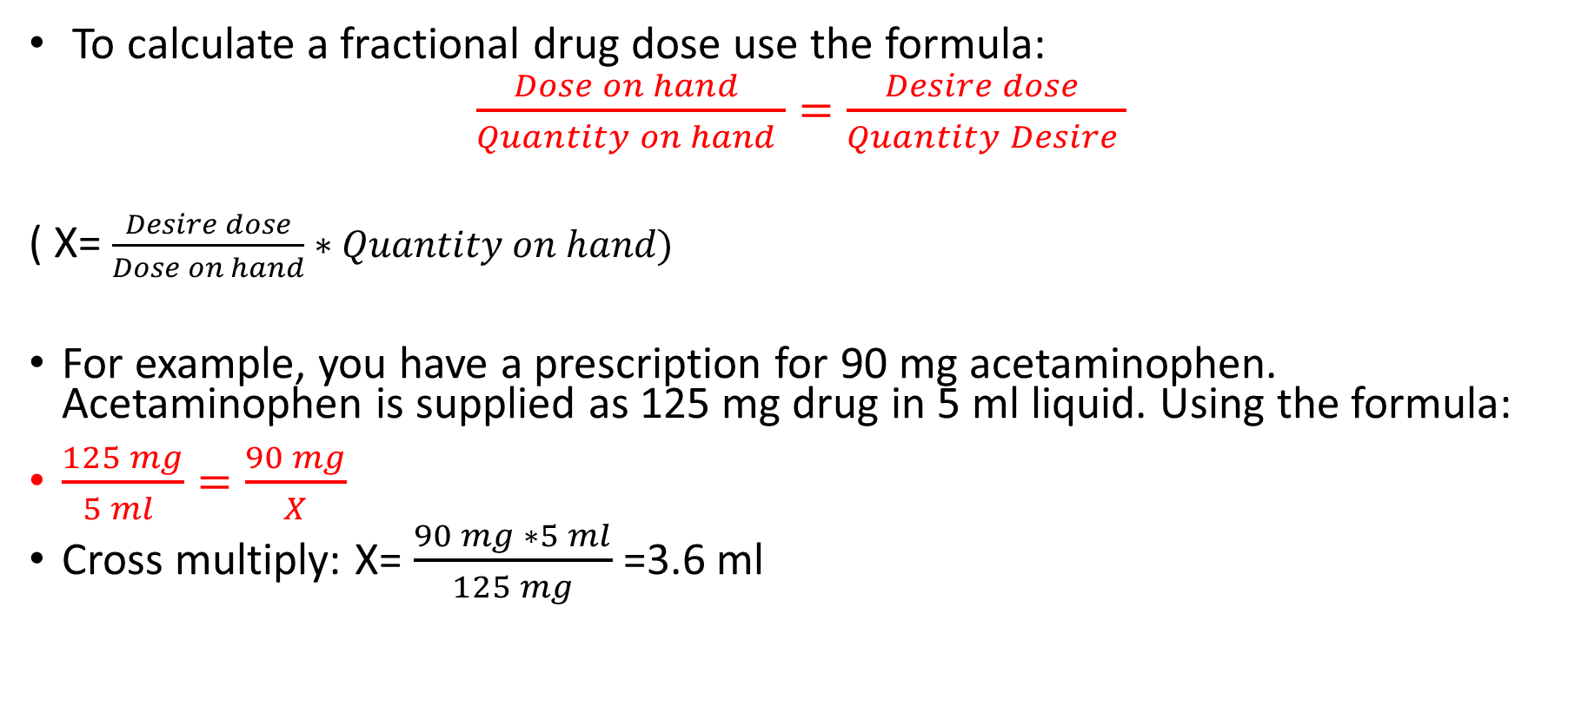
Drug Calculation
To calculate a fractional drug dose use the formula:
$\frac{Dose on hand }{Quantity on hand }=\frac{Desire dose }{Quantity Desire }$
( X= $\frac{Desire dose}{Dose on hand}∗Quantity on hand)$
For example, you have a prescription for 90 mg acetaminophen. Acetaminophen is supplied as 125 mg drug in 5 ml liquid. Using the formula:
$\frac{125 mg}{5 ml }=\frac{90 mg}{X}$
Cross multiply: X= $\frac{90 mg ∗5 ml}{125 mg}$=3.6 ml

Slide 45
Reference text states recommended dosage range is 30 to 50 mg/kg/day in 4 divided doses.
Multiply child’s weight by the lower and upper limits of the dosage range.
• 10 kg × 30 = 300 mg/day
10 kg × 50 = 500 mg/day
Child’s recommended range = 300 to 500 mg/day
Compare physician’s order with dosage range to determine whether medication dosage is safe.
Order reads: Give 500 mg q6h.
  500 mg given q6h = 500 × 4 = 2000 mg/day
Conclusion: Dosage exceeds recommended range.
Dosages outside recommended range should be verified with physician. “Dr. Ahmed, I’ve just reviewed the new medication order for Sara. According to my calculations, the dosage exceeds that recommended for his weight according to both the formulary and pharmacist.

Slide 46
Dosage Calculation (Home work)
Order: Amoxil (amoxicillin) 70 mg PO q8h.
Patient: Child weighs 22 lbs.
Safe dose is 20–40 mg/kg/day in divided doses q8h.
Available as: 125 mg/5 mL
A. Is the dose safe? __________
B. If safe, how much liquid will you give the child per dose? _____________
C. If not safe, what is the range of safe doses for this child? _____________

Slide 47
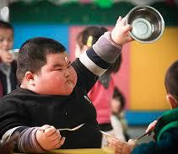
Thank you for listening

